Slide 2
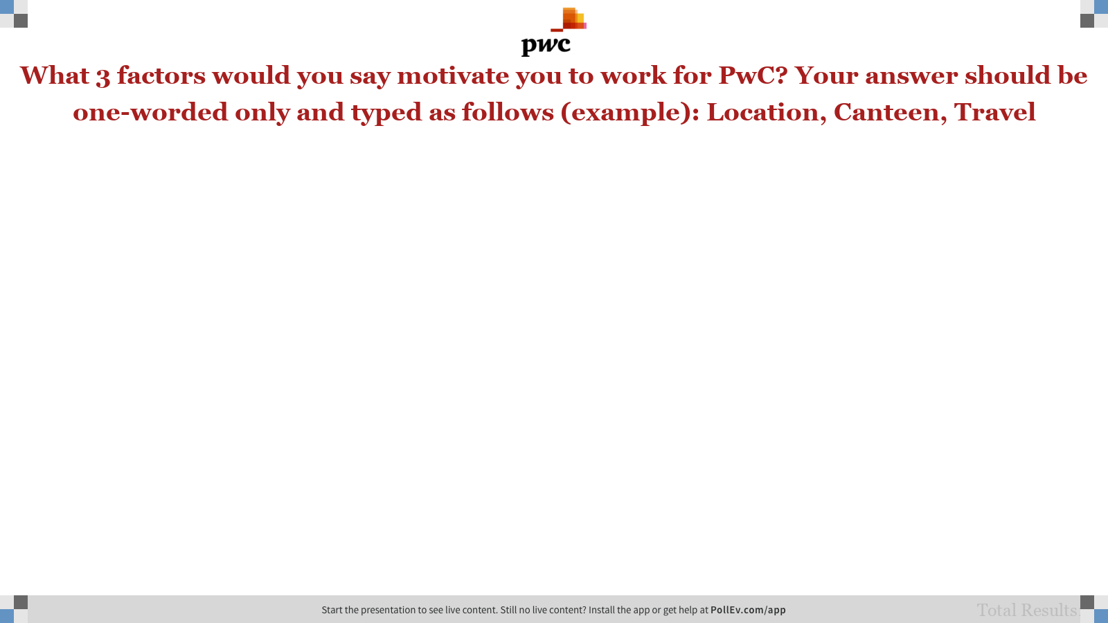
Notes:
Poll Title: What 3 factors would you say motivate you to work for PwC? Your answer should be typed as follows (example): Location, Canteen, Travel https://www.polleverywhere.com/free_text_polls/kEUO7c77B4M8M9T

Slide 3
What 3 factors would you say motivate you to work for PwC? Your answer should be one-worded only and typed as follows (example): Location, Canteen, Travel
Please respond on the link: PollEv.com/presentation

